Slide 1
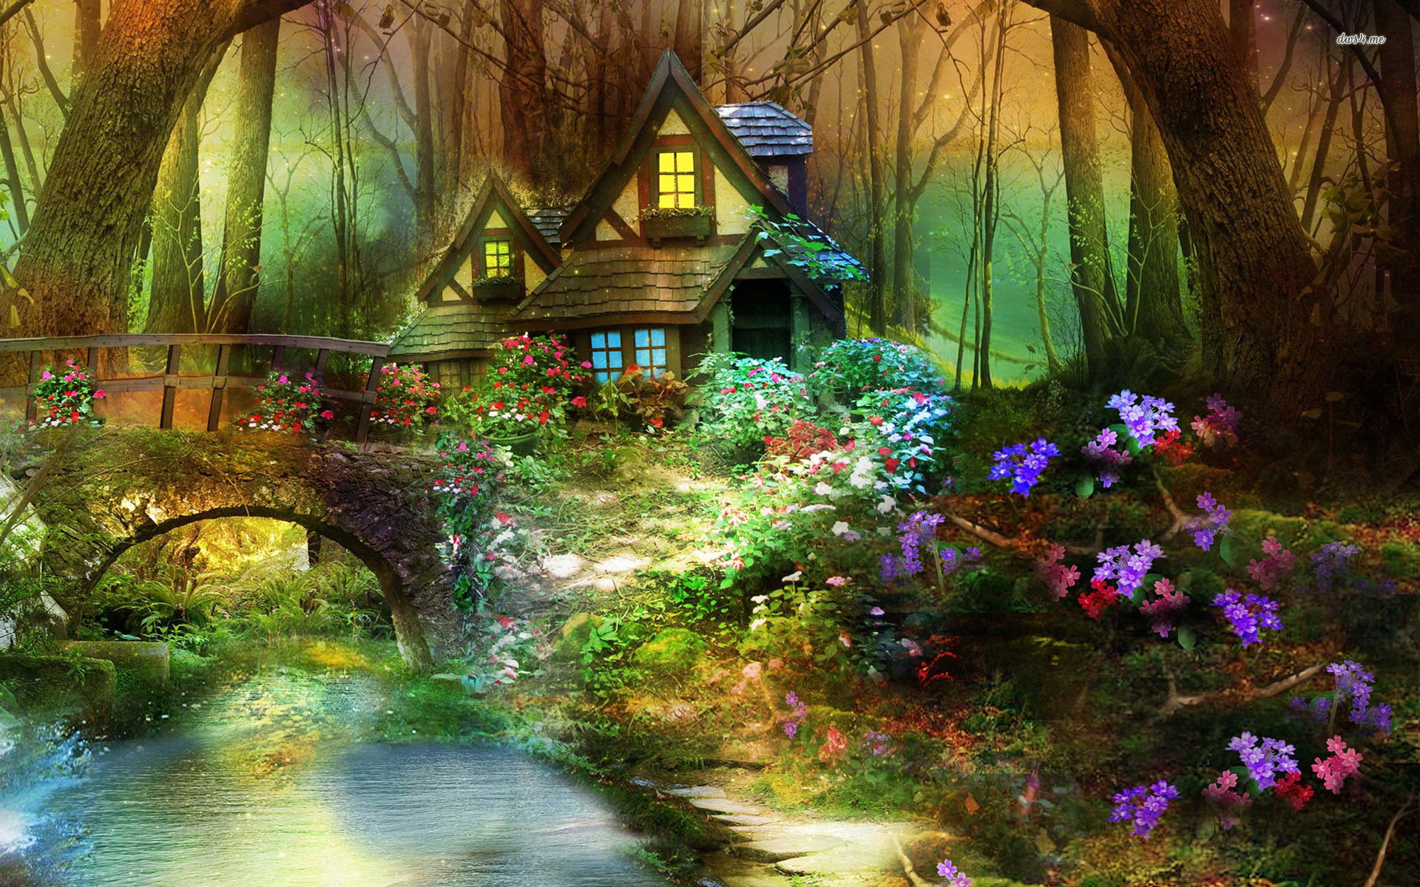
FANTASY ENGLISH CREATURES
Fantasy forest creatures

Slide 2
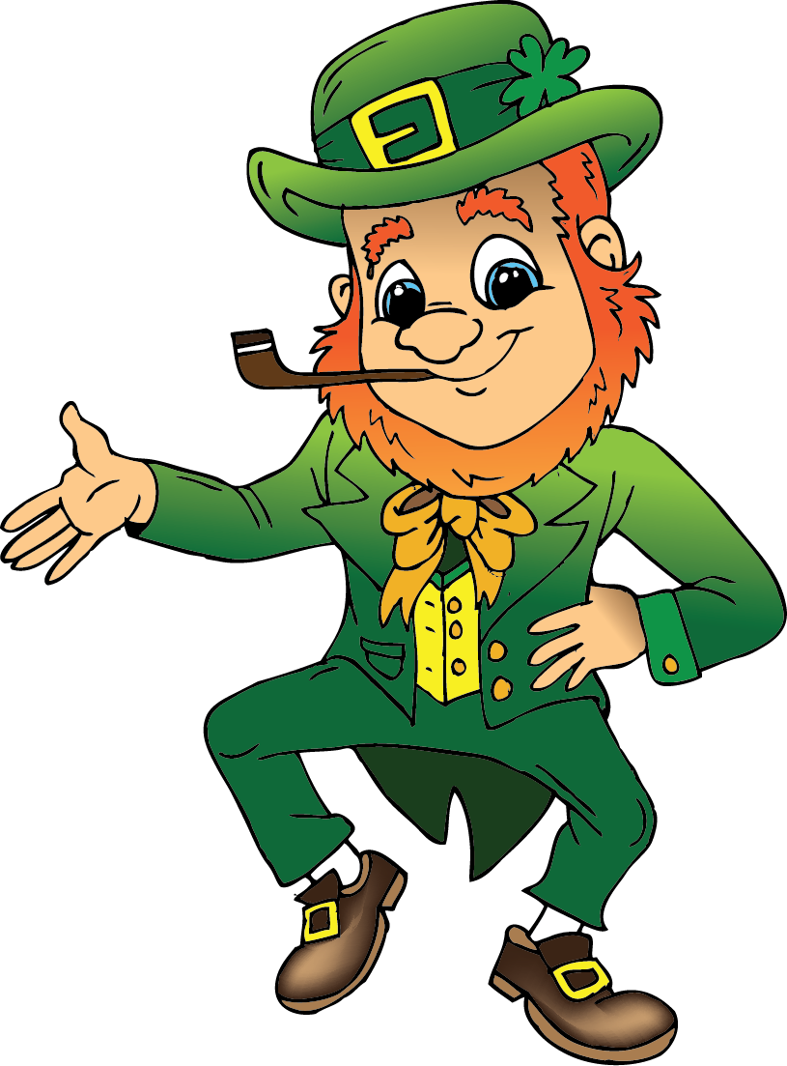
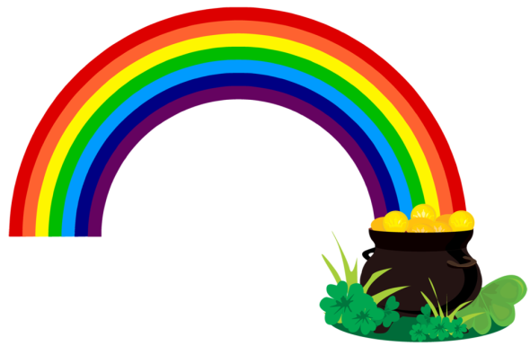
I'm a little leprechaun Dressed in green, The tiniest man That you have seen. If you ever catch me, so it's told, I'll give you my big pot of gold.

Slide 3
A leprechaun is a type of fairy in the Irish folklore.
It is a trickster figure who cannot be trusted.
They make shoes during the day and during the night they dance, sing and drink.
“Because of their love of dancing, they will constantly need shoes.” (W.B.Yeats)

Slide 4
What do they look like?
an old man, wearing a red or green cloak, a beard, a hat and buckled shoes
tall as a small child and small enough to comfortably sit on your shoulder

Slide 5
According to legends, we associate leprechauns with:
MISCHIEF
always like playing tricks on people
A POT OF GOLD
they hide their pots of gold deep in the Irish countryside
RAINBOW
pots are usually at the end of the rainbow
THREE WISHES
if you manage to catch one (and if he doesn´t play a trick on you first ☺), he will grant you three wishes
WHISTLES and FIDDLES
what they play at night

Slide 6
GOBLINS
evil or mischievous dwarf-like creatures – real troublemakers
ugly and naughty
possess various magical abilites
greedy and love gold
scare people and play evil tricks on them

Slide 7
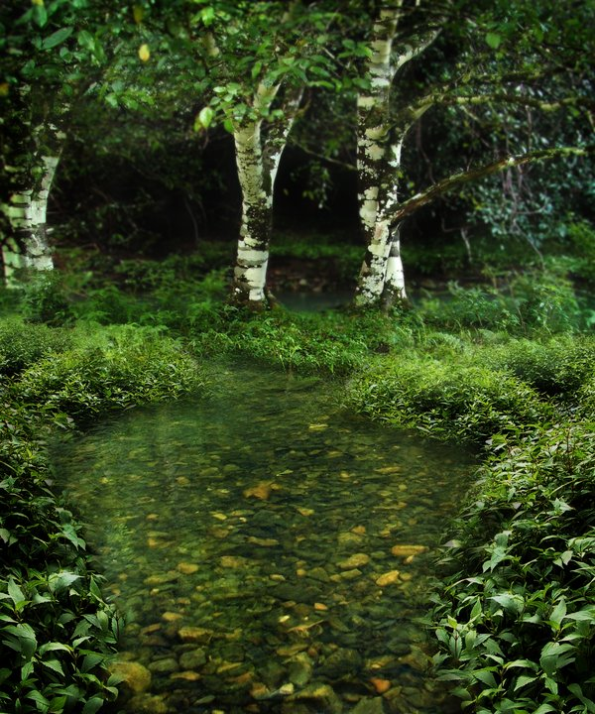
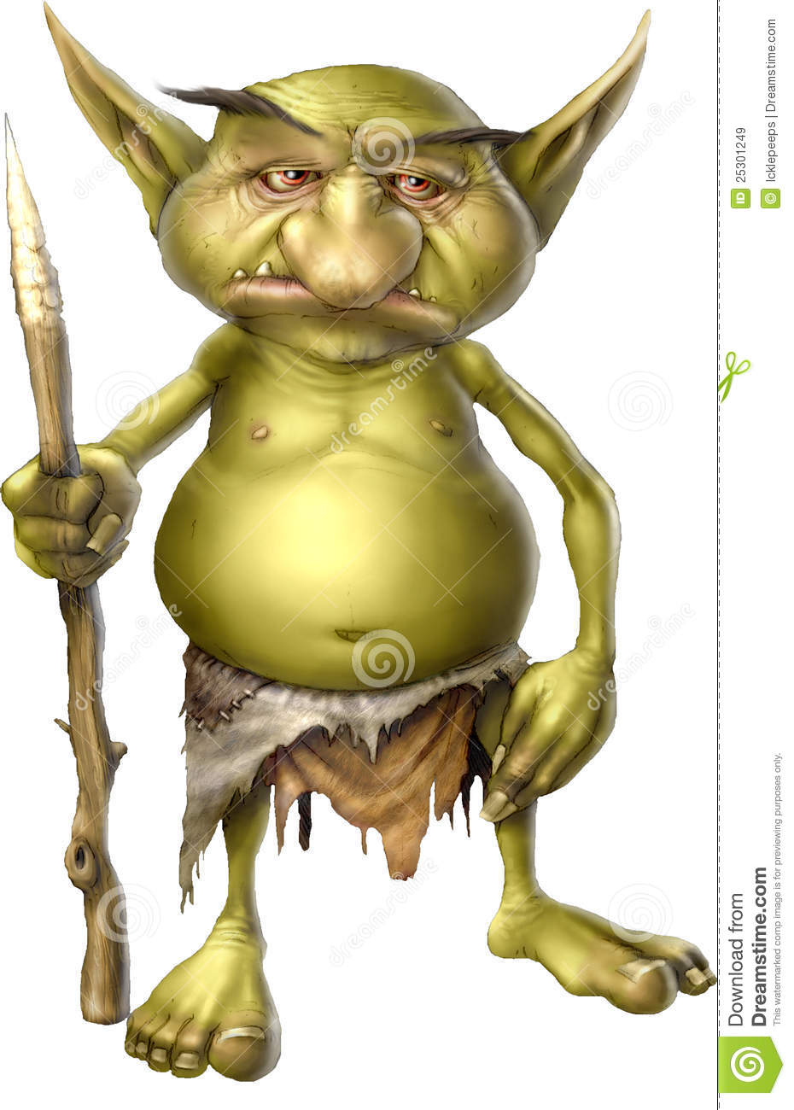
Where do they live?
They live outside, near a pond or stream, some live in caves.

Slide 9
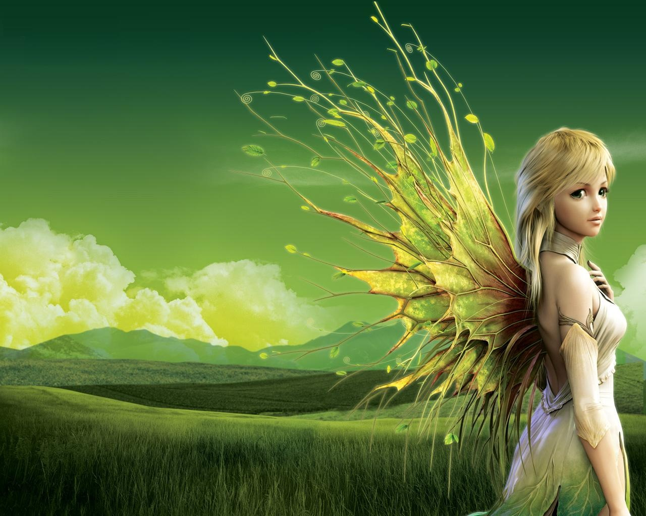
FAIRIES
the most powerful little people in Scotland
they are tiny and have wings, very beautiful
vicious, ill-willed and don´t like mortals

Slide 10
Fairies created mountains, watefalls and lochs.
When they became disappointed with humans, they became invisible.
They can become visible if they step into a fairy ring.

Slide 11
They come to fairy rings to dance and according to legends, they use mushrooms to sit and relax.
Fairy rings are found in fields or meadows.
Fairies love dancing.

Slide 12
KELPIE
a shape-shifting small water-horse
hounts rivers, streams and waterfalls in Scotland
they can appear as big lizards or hairy humans

Slide 13
Kelpies lure fishermen and people passing near the water – if you mount it, it will take you to the deepest lake to drown you.
It is believed that the famous Loch Ness is a kelpie.

Slide 14
BROWNIES
a small, friendly creature, wearing a brown-coloured clothing
they like living on farms
they help with domestic chores, usually at night – you can rarely see them, but you can hear them cleaning

Slide 15
According to legends, they have a sweet tooth, so you can pay them in a bowl of milk, cream, fresh bread or cake.
If you are rude to them, they will play evil tricks on you.
To get rid of them, leave them a new cloak or hood and they will never appear again.

Slide 16
How much do you remember?
Who helps people with domestic chores?
Who wears a green cloak, a beard and a hat?
Who likes dancing in a ring?
Who changes shape in order to lure people and drown them?
Who has wings?
Who is very ugly and naughty, always scaring people?
Who keeps their treasure at the end of the rainbow?
What is Loch Ness?
Who created mountains, waterfalls and lochs?
Who will grant you three wishes for their freedom?

Slide 17
THANK YOU!

