Slide 1
FANTASY FOREST

Slide 2
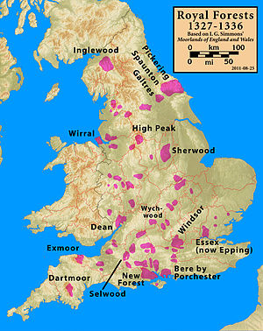
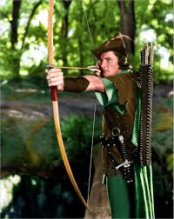
Sherwood, Nottinghamshire
• a royal forest in Nottinghamshire, England,
famous by the legend of Robin Hood,
a heroic outlaw "robbing from the rich and giving
to the poor“.

Slide 3
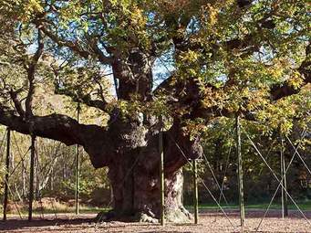
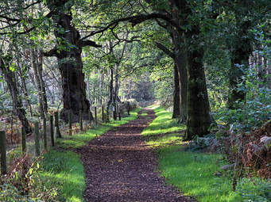
Major Oak
• according to local folklore it was Robin Hood's principal hideout.
• between 800 and 1,000 years old.

Slide 4
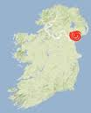
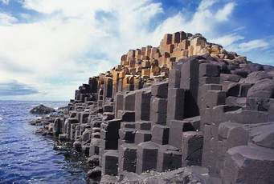
Slieve Gullion Forest Park, County Armagh (Ireland)
•
the Irish Giant Finn McCool was often found here. He decided to build a causeway to Scotland so that he could challenge his rival, a Scottish giant Benandonner, in battle.
• the Giant's Causeway - declared a World Heritage Site by UNESCO in 1986.
• most of the columns are hexagonal but there are also some with four, five, seven and eight sides, the tallest is 12 m tall.

Slide 5
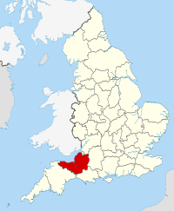
Shervage Wood, Somerset
• famous for a mighty dragon the Gurt Wurm of Shervage Wood.
The Gurt Wurm of Shervage Wood - legend

Slide 6
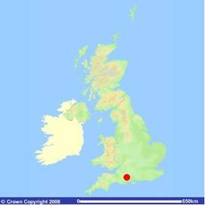
Savernake forest, Wiltshire
• you can meet the ghost of a white deer, a headless woman riding on a horse, a phantom coach and horses, or black hounds that bring bad luck to all who see them.

Slide 7
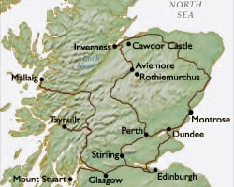
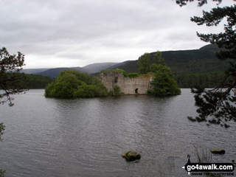
Rothiemurchus, Inverness-shire
• several visitors pursued by an invisible being that seemed human but ran on four hooves.
• home to the grave of the Chief of Clan Shaw, whose spirit is said to challenge those who stray too deep into the forest .
“Accept the challenge and the spirit will leave you be, but be cowardly and run, and you will never be seen again.”
• Goblins, elves and other creatures live here.

Slide 8
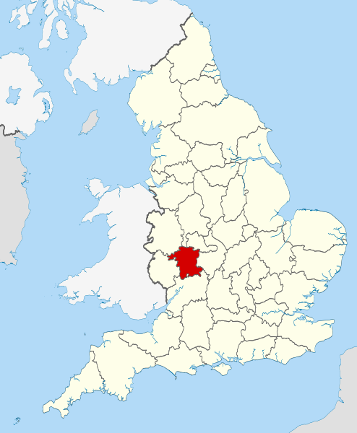
Uffmoor wood, Worchestershire
• The waters of a spring in this forest gained a reputation for their curative powers and soon drew pilgrims.
• People still come for healing and leave a strip of clothing on a nearby bush.

Slide 9
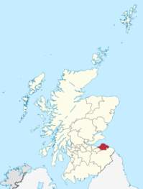
Pressmennan wood, East Lothian
• Glingbobs - part woodlouse, part bumble bee and live in decaying trees.
• Tootflits - dragonfly/weevil creatures that inhabit high branches
• children look for the tiny doors and glass windows in the trees behind which these creatures live.

Slide 10
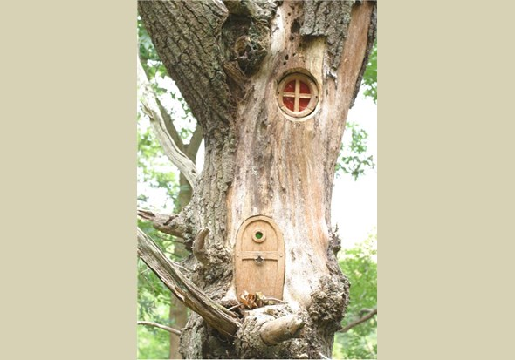
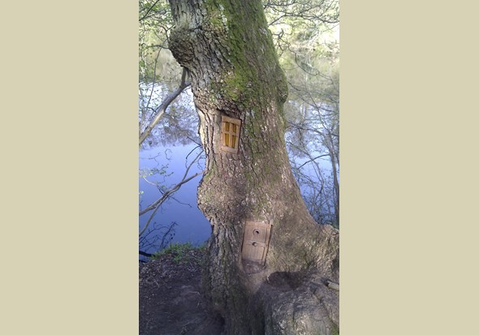
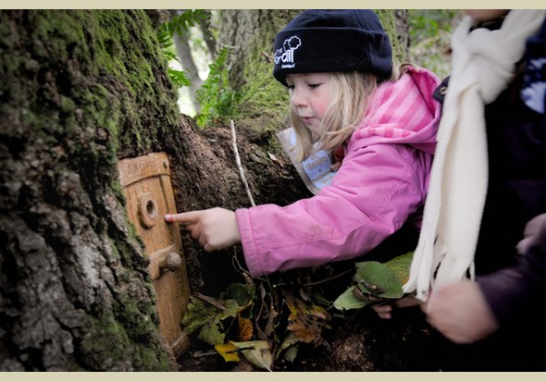

Slide 11
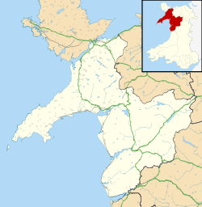
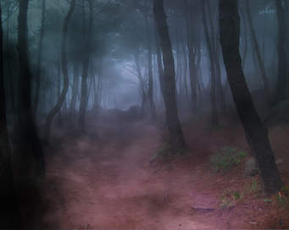
Beddgelert Forest, Gwynedd
• Gelert, the faithful servant of Prince Llewelyn the Great, risked his life to save his master's baby son from a wolf and
went to greet Llewelyn dripping with the beast's blood. The prince thought it was his son's blood and killed Gelert, whose grave ("bedd") can be found in this forest. That's why you can meet his ghost while walking there.

Slide 12
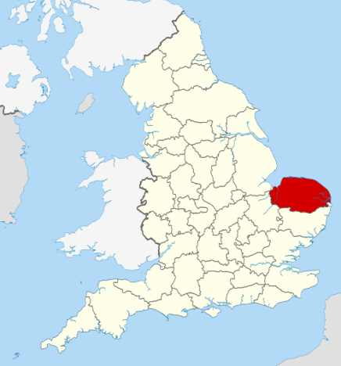
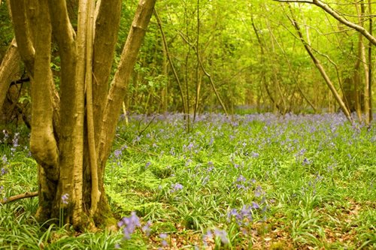
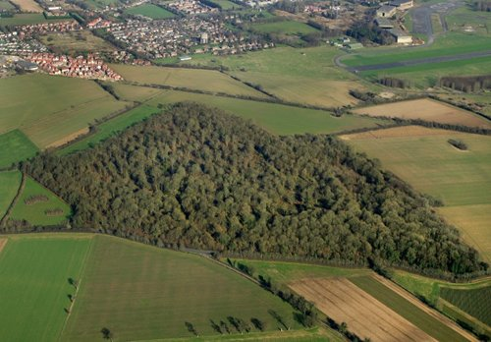
Wayland Wood, Norfolk
•˝Babes in the wood˝ - the centuries old legend tells that these two children, brother and sister, were left to their uncle after the death of their parents. They were to inherit their father's fortune, but if they die before this time the wealth would go directly to the uncle. So the uncle abandons the two children to die in the wood.
•In 1879, the tree that the babes had been left under was struck by lightning and people visited the area for souvenirs.

